Slide 1
Deep Learning Hands-On

Slide 2
Deep Learning in One Slide
Exciting Progress:
Face recognition
Image classification
Speech recognition
Text-to-speech generation
Handwriting transcription
Machine Translation
Medical diagnosis
Autonomous driving
Game playing with deep RL
What is it:
Extract useful pattern from data
How:
Neural Networks + optimization
Tools:
Python + Tensorflow & Others
Hard Part:
Good Questions + Good Data

Slide 3
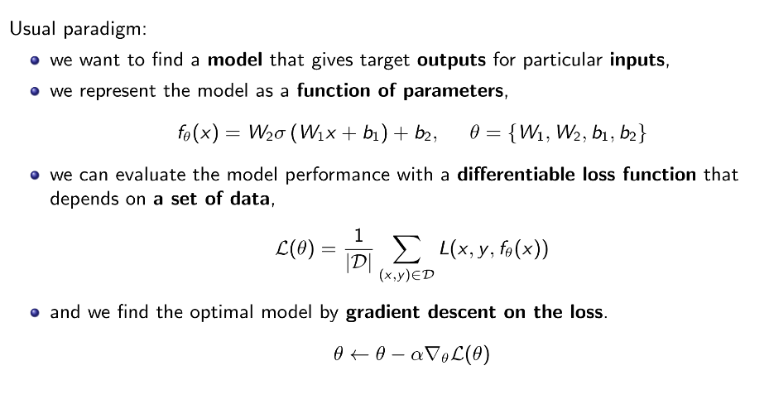
Deep Learning

Slide 4
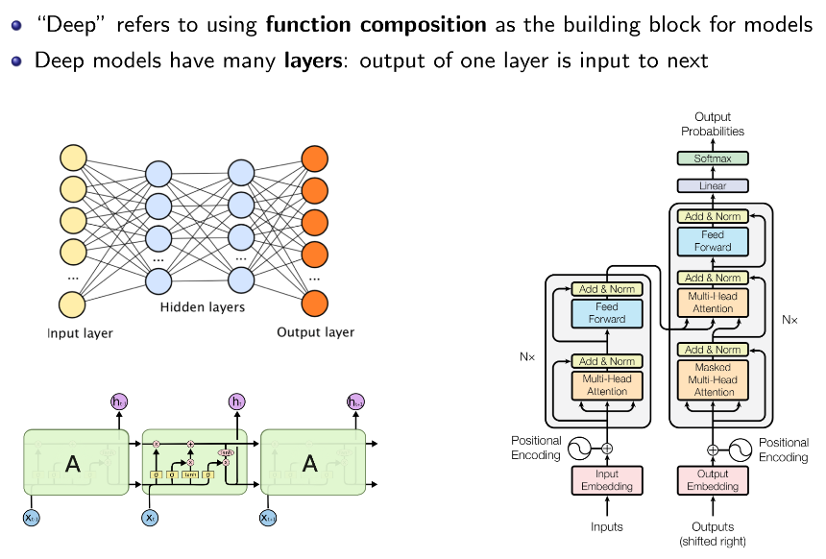
Why Deep Learning?

Slide 5
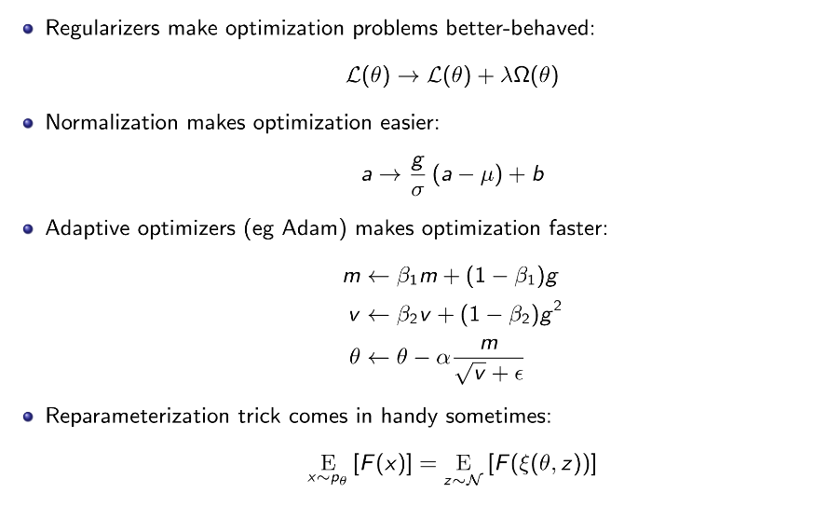
Is all good?

Slide 6

Tensorflow in One Slide
What is it: Deep Learning Library
Open Source, Python, Google
Community:
117,000+ GitHub stars
Tensorflow.org: Blogs, Documentation, Youtube talks
Ecosystem:
Keras: high-level API
Tensorflow.js: in the browser
Tensorflow Lite: on the phone
Colaboratory: in the cloud
TPU: optimized hardware
Tensorboard: visualization
Tensorflow Hub: graph models
Extras:
Tensorflow Serving
Tensorflow Extended
Tensorflow Probability

Slide 7
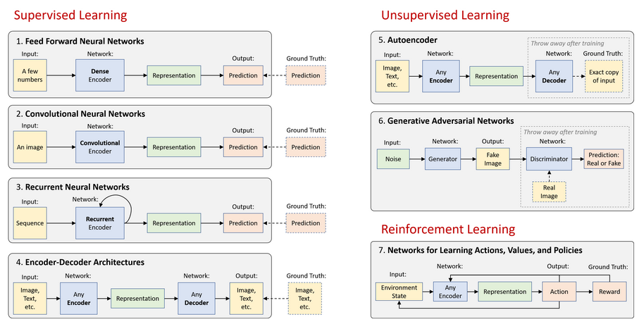

Slide 8
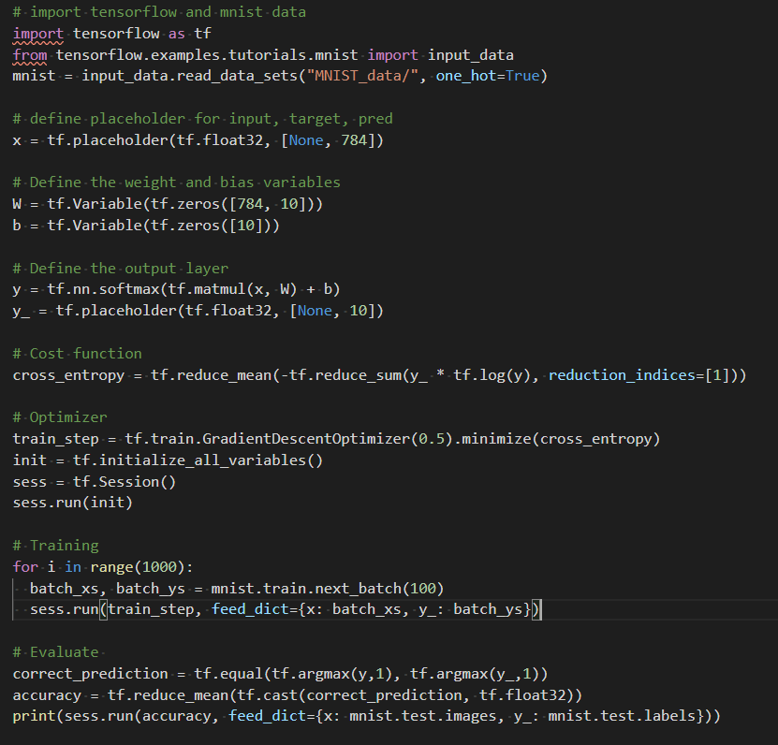
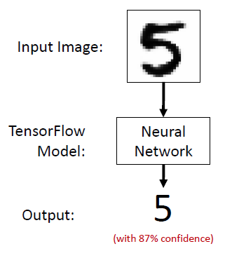
First Steps: Small Example

Slide 9
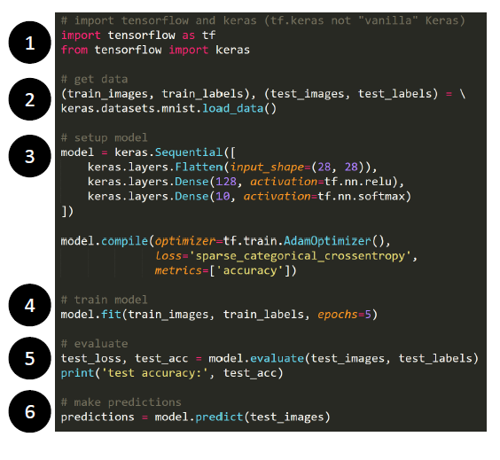
First Steps: Small Example

Slide 10
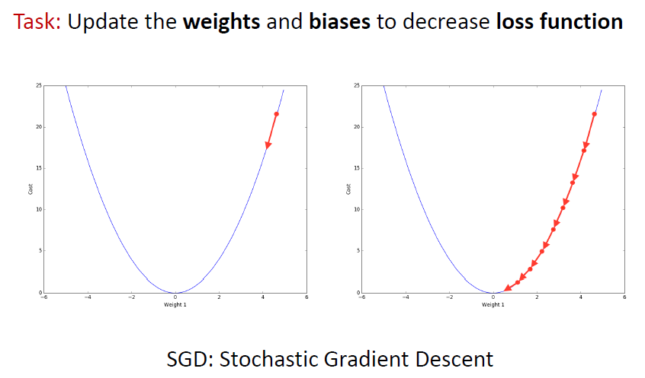
Learning is an Optimization Problem

Slide 11
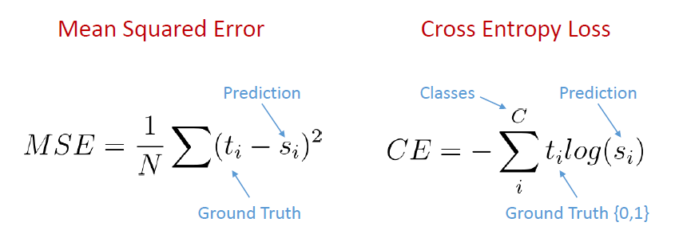
Loss Functions
Quantifies gap between prediction and ground truth
Regression
Classification

Slide 12
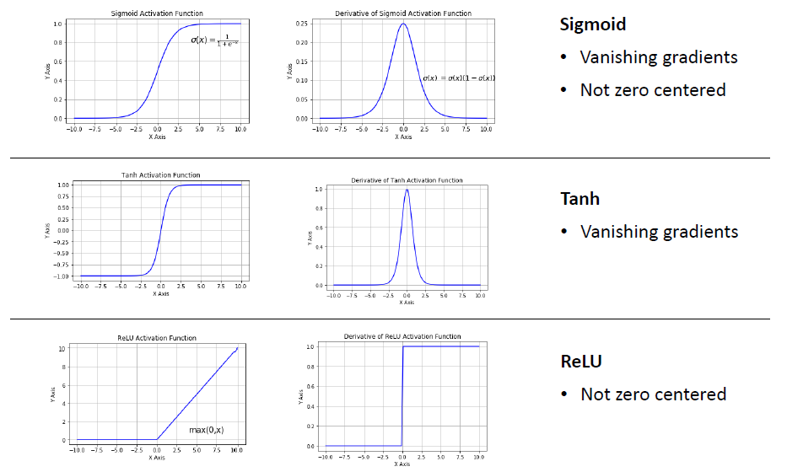
Activation Functions

Slide 13
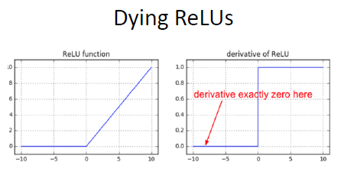
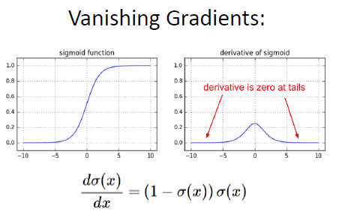
Common obstacles in DL
Poorly initialized, a neuron might never “fire” for the entire dataset
Large parts of a network could be dead ReLUs!
Backpropagation:
Partial derivatives are small then the learning is slow

Slide 14
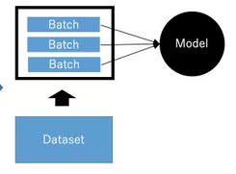
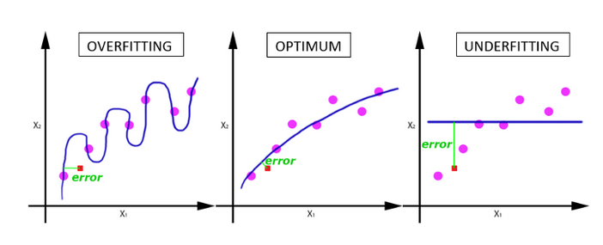
Overfitting and Regularization
Network should be able to generalize to data it hasn’t seen
Big problem for small dataset
Mini-Batch Size:
Large dataset cannot pass entire to the network, we should divide into a certain number of batches
Larger batch size = more speed
Smaller batch size = better generalization

Slide 15
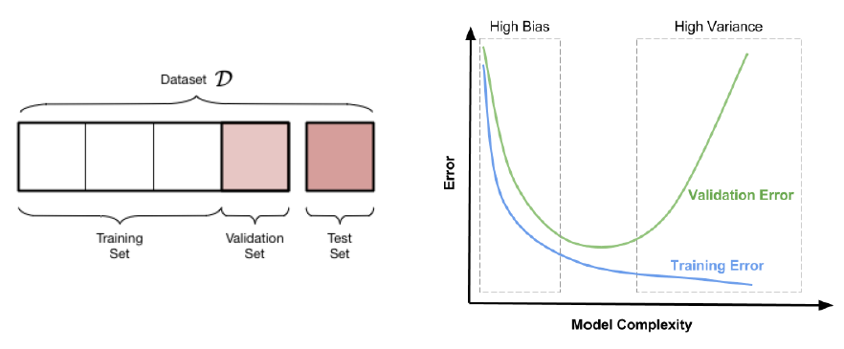
Regularization: Early Stopping
Create a validation set (assume to be a representation of the testing set)
Early stopping: Stop an save the last checkpoint when performance on
validation set decreases

Slide 16
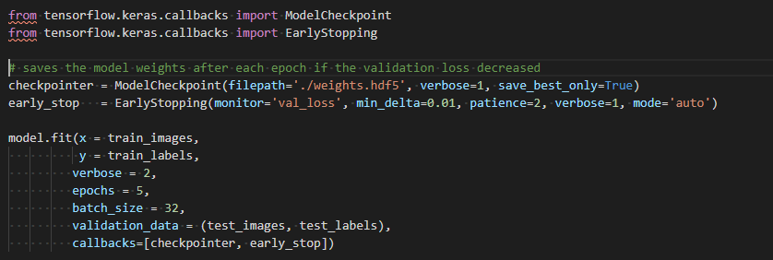
Regularization: Early Stopping

Slide 17
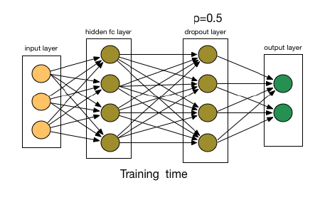
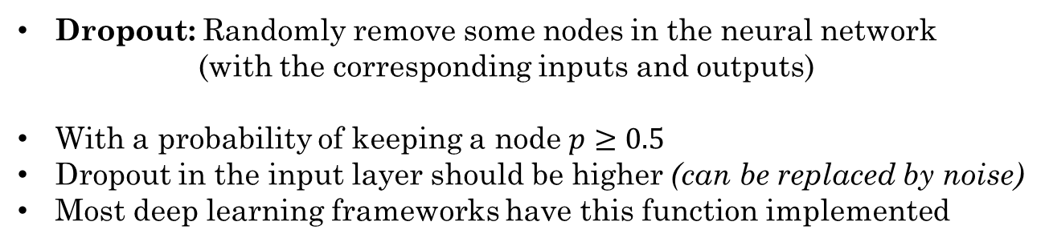
Regularization: Dropout
Dropout: Randomly remove some nodes in the neural network
(with the corresponding inputs and outputs)
With a probability of keeping a node $p≥0.5$
Dropout in the input layer should be higher (can be replaced by noise)
Most deep learning frameworks have this function implemented

Slide 18
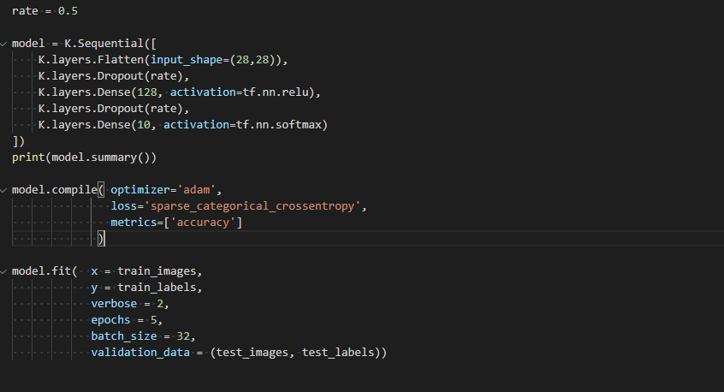
Regularization: Dropout

Slide 19
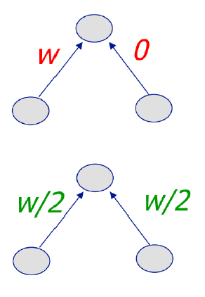
Regularization: Weight Penalty
L2 Penalty
Keeps weight small unless error derivative is very large
Prevent from fitting sampling error
Output changes slower as the input changes
Balance similar inputs instead of weight all on one
L1 Penalty
Allow for few weights to remain large
Penalize absolute weights

Slide 20
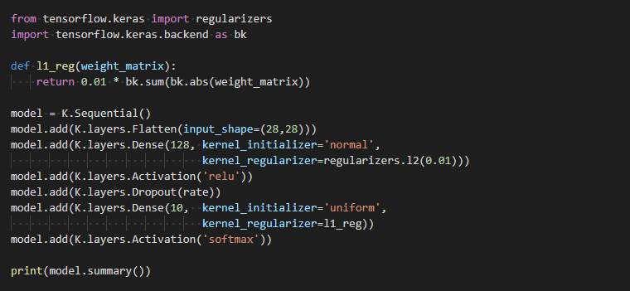
Regularization: Weight Penalty

Slide 21
Regularization: Normalization
Input Normalization
Manage the input scale
Whitening
Scale according to the mean and std.
Batch Normalization
Normalize hidden layer inputs
Use mini-batch mean and variance
Reduce the impact of earlier layers to more deep layers
Batch Renormalization
Fixes difference b/w training and inference by keeping a moving average asymptotically approaching a global normalization

Slide 22
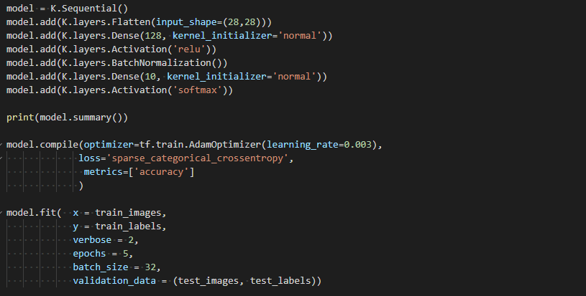
Regularization: Normalization

Slide 23
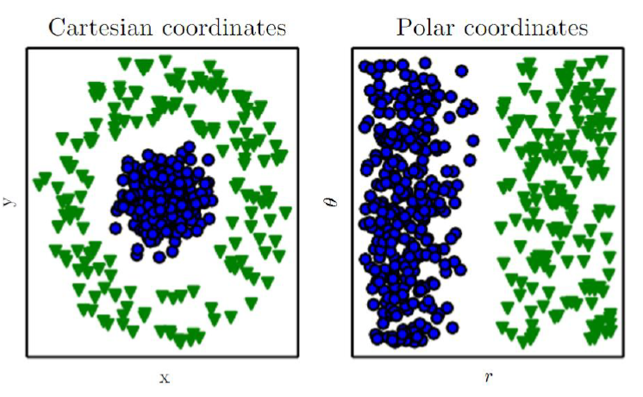
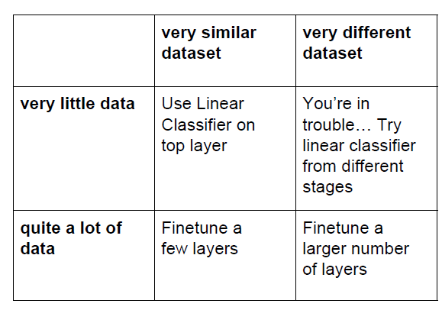
Representation and Data Dimension

Slide 24




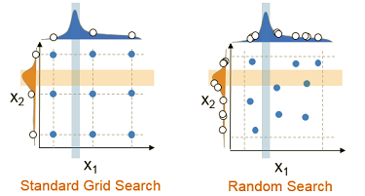
Optimization
Learning rate
Batch size
Hidden nodes
Software
Hyper-parameters can be
tuned by an Grid Search
Grid Search and Random Search.
Choose Model
Parallelism
Cross-validation between models
Tensorflow Model
Keras Abstraction
Grid Search Sklearn
Obtain best Parameters
High level API, run on top
Of TensorFlow, Theano
Run CPU-GPU
Tools for data mining
Numpy, SciPy, Matplotlib

Slide 25
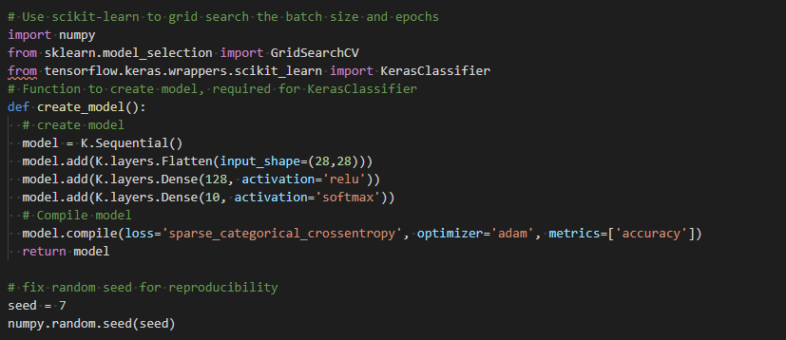
Grid-Search

Slide 26
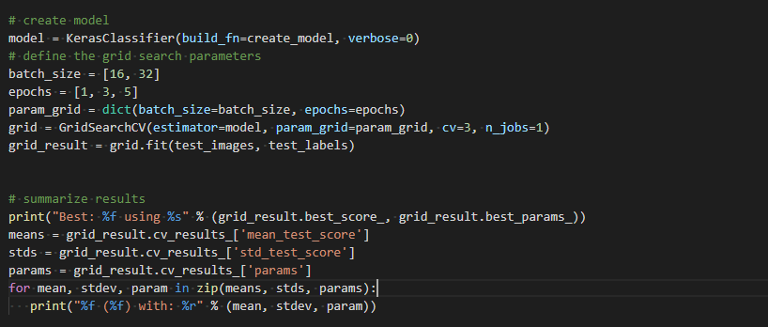
Grid-Search

Slide 27
BREAK

Slide 28
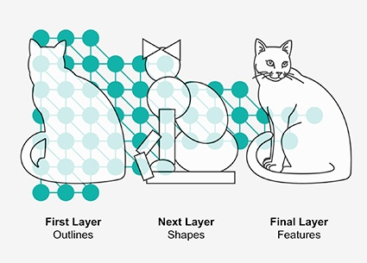
Convolutional Neural Networks

Slide 29
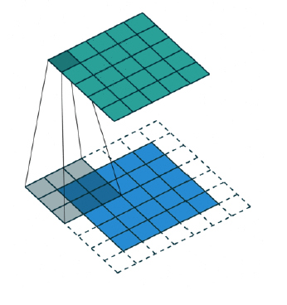
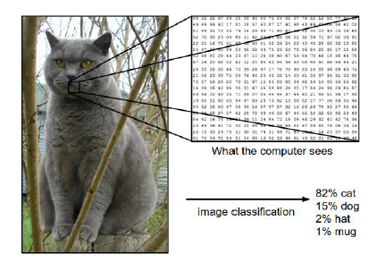
Convolution Networks
Filter that take
Advantage of
Spatial invariance

Slide 30
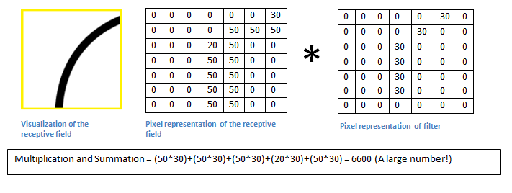
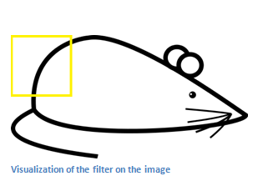

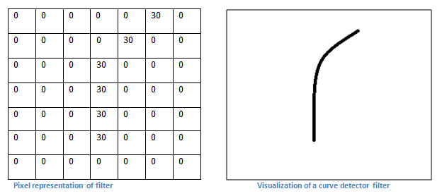
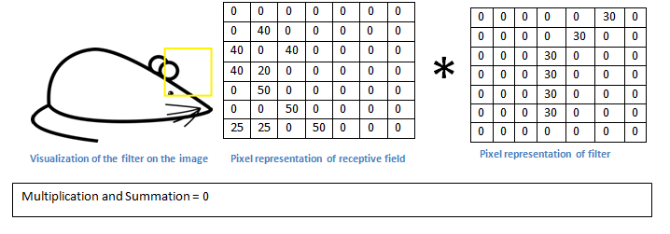
Convolution Networks
Input Data
Convolution filter

Slide 31
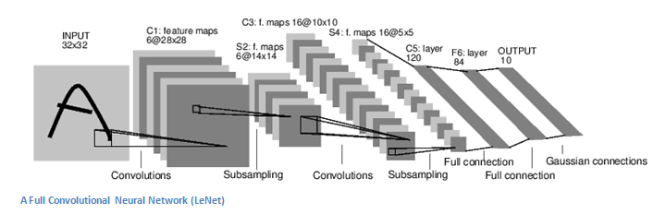
Convolution Networks

Slide 32
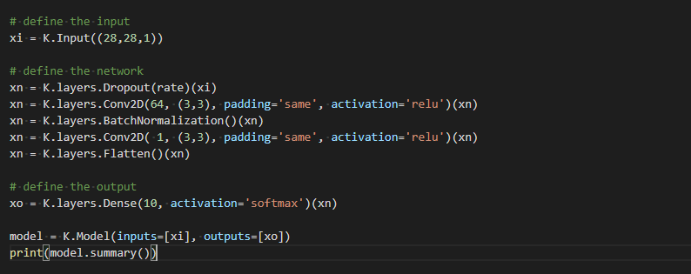
CNN

Slide 33
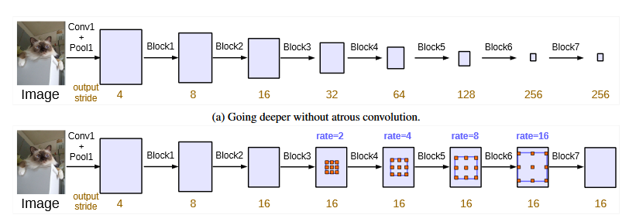
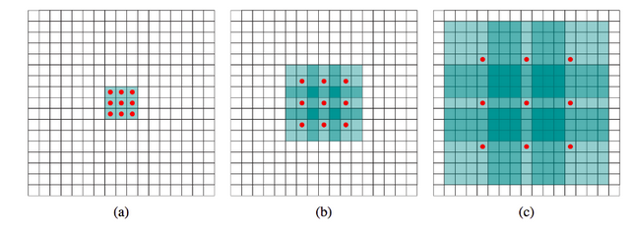
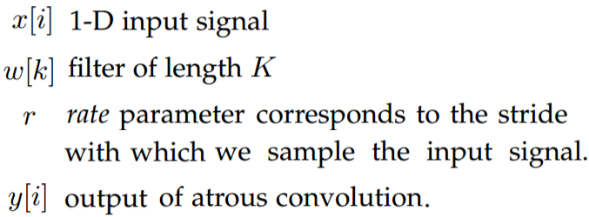
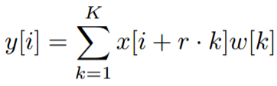
Atrous Convolution
Remove the down-sampling from the last pooling layers.
Up-sample the original filter by a factor of the strides: Atrous convolution for 1-D signal:
Note: standard convolution is a special case for rate r=1.
Introduce zeros between filter values

Slide 34
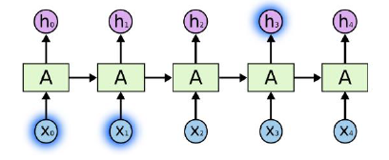
Recurrent Neural Networks

Slide 35
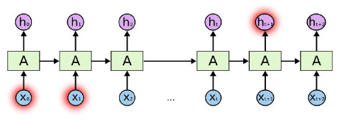
Recurrent Neural Networks
(Long-Term Dependency)
Short-Tem dependence
Bob is eating an apple.
Long-Term dependence
Bob likes apples. He is hungry and decided to have a snack. So now he is eating an apple.
In theory, vanilla RNN can handle arbitrarily long-term dependence
(In practice, it’s difficult)

Slide 36
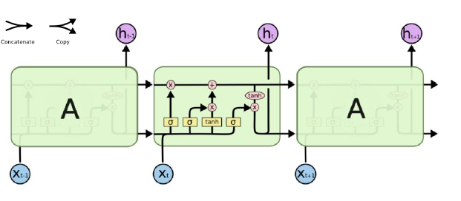
Long Short-Term Memory (LSTM)
Pipeline for storing a previous state and process new incoming data:
Decide what to forget
Decide what to remember
Decide what to output

Slide 37
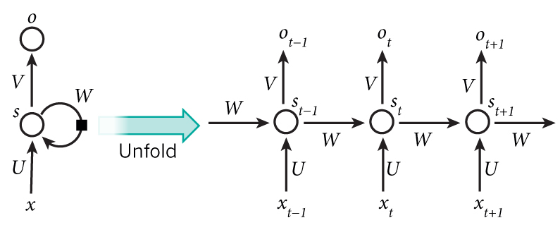
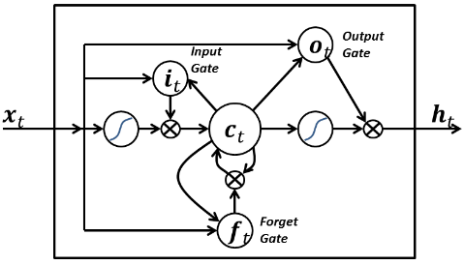

RNN architectures
Long Short Term Memory - LSTM
Useful
Diagram
Equations
Training a Gradient Descent Algorithm
Vanishing Gradient
Exploding Gradient
Includes new terms:
Input gate
Output gate
Effect state of memory
Recurrent connection
Forget gate
Module the memory cell self-recurrent connection
State of cell
Remember or forget
LSTM
Input gate → Incoming signal alter state of memory
$$i_{t}=σ\left(U_{i}x_{t}+W_{i}s_{t−1}+b_{i}\right)$$
Candidate Cell → States of memory at time $t$
$$\tilde{c_{t}}=tanh\left(U_{c}x_{t}+W_{c}s_{t−1}+b_{c}\right)$$
Forget gate →activation of memory
$$f_{t}=σ\left(U_{f}x_{t}+W_{f}s_{t−1}+b_{f}\right)$$
State of cell → new state
$$c_{t}=f_{t}∗c_{t−1}+i_{t}∗\tilde{c_{t}}$$
Output and hidden gate
$$o_{t}=σ\left(U_{o}x_{t}+W_{o}s_{t−1}+V_{o}c_{t}+b_{o}\right)$$
$$s_{t}=o_{t}∗tanh\left(c_{t}\right)$$
$$s_{t}$$
Sepp Hochreiter; Jürgen Schmidhuber (1997). "Long short-term memory”
$$D_{i}=\left[A_{i},G_{i} \right]=[batch, timestep, depth]$$
K. Greff, R. K. Srivastava, J. Koutník, B. R. Steunebrink and J. Schmidhuber, "LSTM: A Search Space Odyssey,"
$$D_{i}=\left[A_{i},G_{i} \right]=[timestep, (batch,depth)]$$

Slide 38
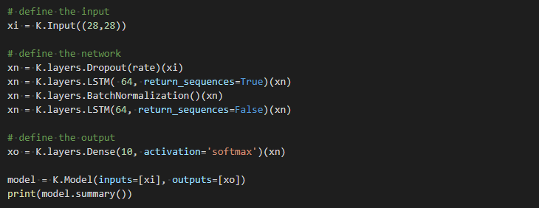
LSTM

Slide 39

RNN architectures
Gate Recurrent Unit
Useful
Diagram
Equations
It combines the forget and input gates into a single “update gate.”
It also merges the cell state and hidden state
They have fewer parameters than LSTM
Prove to be better for a specific cases (most of studies are in NLP or Music Generation)
GRU
Update gate → Incoming signal alter state of memory
$$z_{t}=σ\left(U_{i}x_{t}+W_{i}s_{t−1}+b_{z}\right)$$
Reset gate → activation of memory
$$r_{t}=σ\left(U_{r}x_{t}+W_{r}s_{t−1}+b_{r}\right)$$
Candidate cell → States of memory
$${\tilde{s}}_{t}=tanh\left(U_{c}x_{t}+W_{c}\left(r_{t}∗s_{t−1}\right)+b_{c}\right)$$
Output and hidden state
$$s_{t}=z_{t}∗s_{t−1}+\left(1−z_{t}\right)∗{\tilde{s}}_{t}$$
$$r_{t}$$
x
$${\tilde{s}}_{t}$$
$$s_{t}$$
$$∫$$
Cho, Van Merrienboer, Bengio, "Learning Phrase Representations using RNN Encoder-Decoder for Statistical Machine Translation", 2014
$$z_{t}$$
$$s_{t−1}$$
Chung, Gulcehre, Cho, Bengio, "Empirical Evaluation of Gated Recurrent Neural Networks on Sequence Modeling", 2014

Slide 40
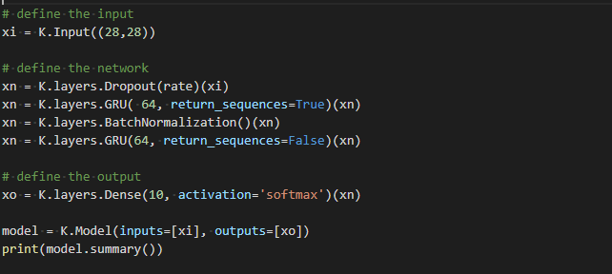
GRU

Slide 41
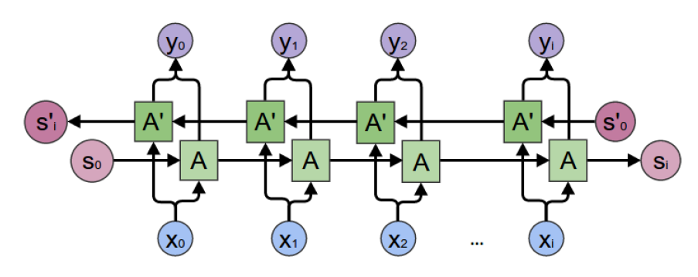
Bidirectional RNN
Learn a representation after watching a sequence from both:
Previous time steps and future time steps

Slide 42


RNN architectures
Bi-directional LSTM
Useful
Diagram
Equations
LSTM
Input gate → Incoming signal alter state of memory
$$i_{t}=σ\left(U_{i}x_{t}+W_{i}s_{t−1}+b_{i}\right)$$
Candidate Cell → States of memory at time $t$
$$\tilde{c_{t}}=tanh\left(U_{c}x_{t}+W_{c}s_{t−1}+b_{c}\right)$$
Forget Cell →activation of memory
$$f_{t}=σ\left(U_{f}x_{t}+W_{f}s_{t−1}+b_{f}\right)$$
State of cell → new state
$$c_{t}=f_{t}∗c_{t−1}+i_{t}∗\tilde{c_{t}}$$
Output and hidden state
$$o_{t}=σ\left(U_{o}x_{t}+W_{o}s_{t−1}+V_{o}c_{t}+b_{o}\right)$$
$$s_{t}=o_{t}∗tanh\left(c_{t}\right)$$
Based on the element's past and future contexts.
Proved to be especially useful when combined with LSTM RNN
This is done by concatenating the outputs of two RNNs:
sequence from left to right
sequence from right to left
Mike Schuster and Kuldip K. Paliwal, “Bidirectional Recurrent Neural Networks”, 1997
Alex Graves and Jurgen Schmidhuber, Framewise Phoneme “Classification with Bidirectional LSTM and Other Neural Network Architectures”, 2005

Slide 43

BRNN

Slide 44

Autoencoder Neural Networks

Slide 45

Autoencoder Networks
At its most basic, an autoencoder is a neural network trained to copy its input to its output. Internally consists of two parts: an encoder function f(x) and a decoder function g(h). Instead of simply learning to copy, autoencoders are desgined to be unable to copy perfectly. Beacuse the model is forced to prioritize which aspects of the input should be copied, it often learns useful properties of the data.

Slide 46

Autoencoder

Slide 47

Autoencoder

Slide 48

Variational Autoencoder

Slide 49


VAE

Slide 50

VAE

Slide 51

U-Net Autoencoder

Slide 52

U-Net

Slide 53

U-Net

Slide 54
BREAK

Slide 55

Recent Works for Time Series* *available code

Slide 56

LSTM Fully Convolutional Networks for Time Series Classification
https://ieeexplore.ieee.org/stamp/stamp.jsp?tp=&arnumber=8141873
https://github.com/titu1994/LSTM-FCN

Slide 57

An Empirical Evaluation of Generic Convolutional and Recurrent Networks for Sequence Modeling
https://arxiv.org/pdf/1803.01271v2.pdf
https://github.com/philipperemy/keras-tcn

Slide 58
Thanks
Contact:
patoalejor@gmail.com

